Slide 1
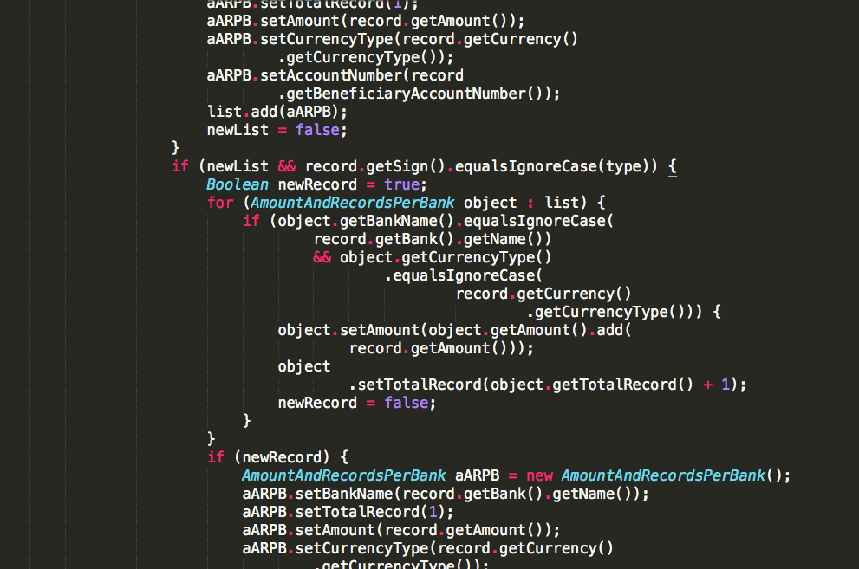

Slide 2
Too Long

Slide 3
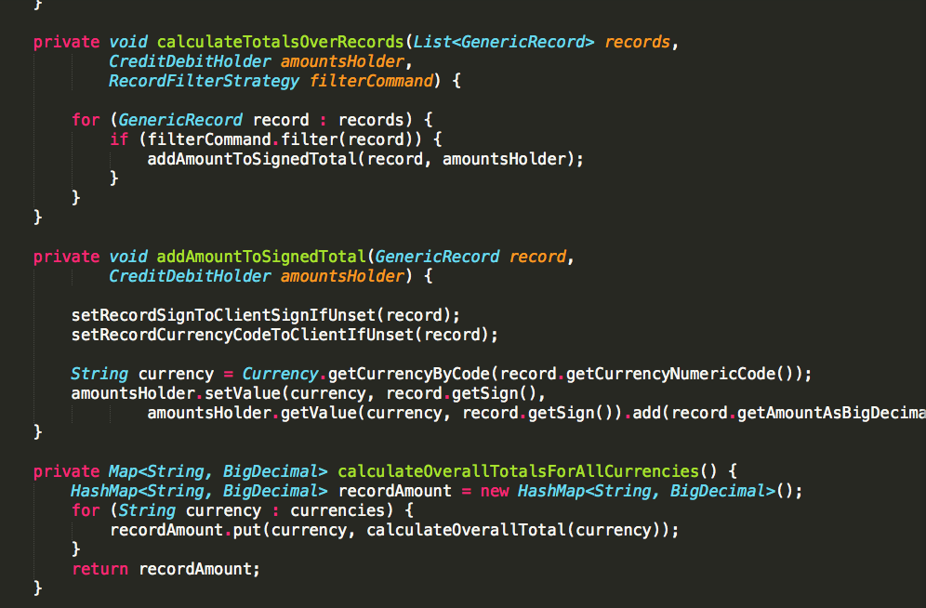

Slide 4
Short Enough

Slide 5
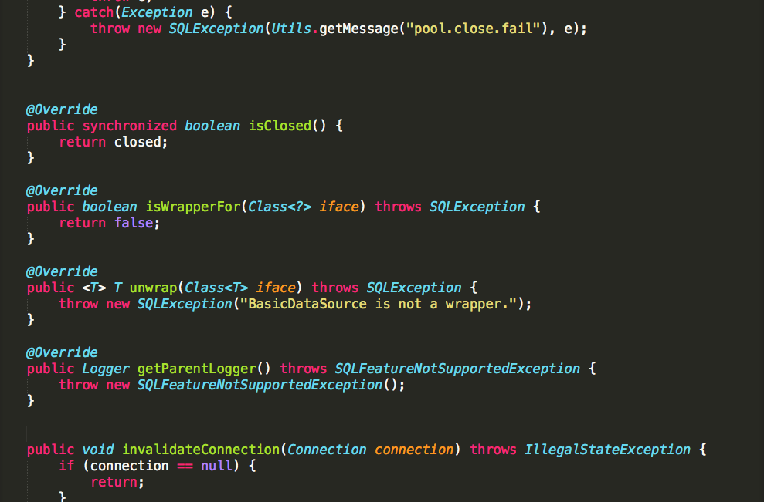

Slide 6
Short Enough

Slide 7
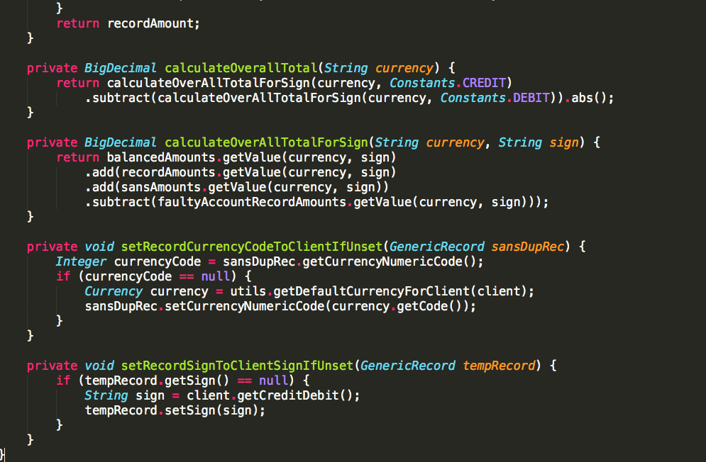

Slide 8
Short Enough

Slide 9
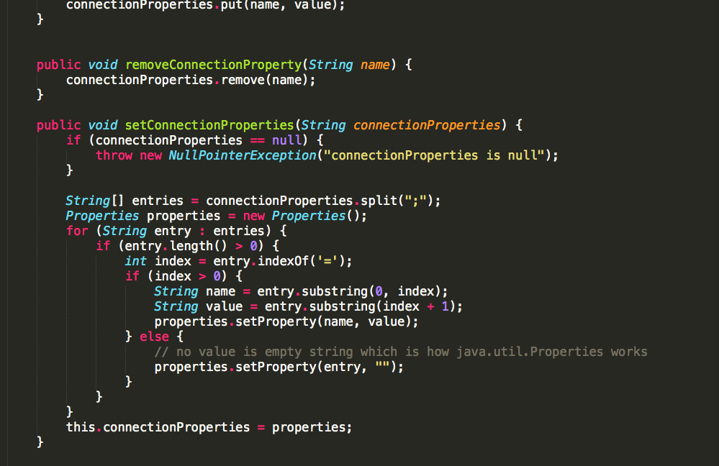

Slide 10
Short Enough

Slide 11
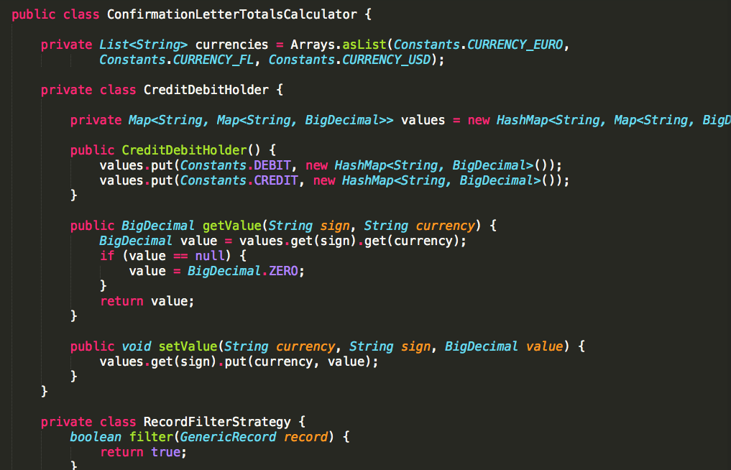

Slide 12
Short Enough

Slide 13
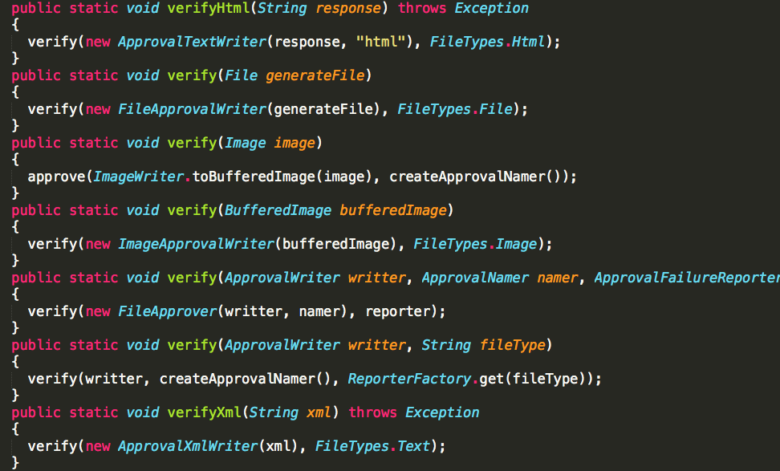

Slide 14
Short Enough

Slide 15
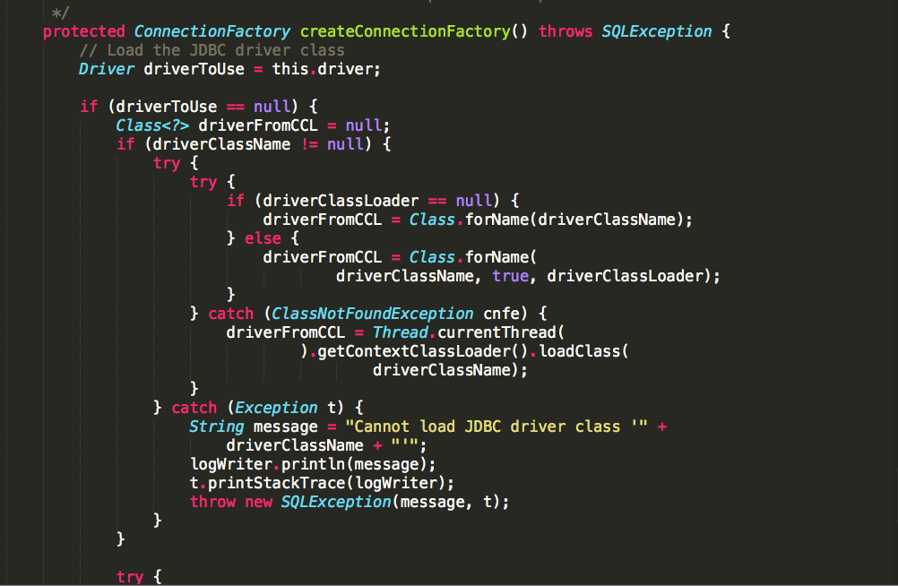

Slide 16
Too Long

Slide 17
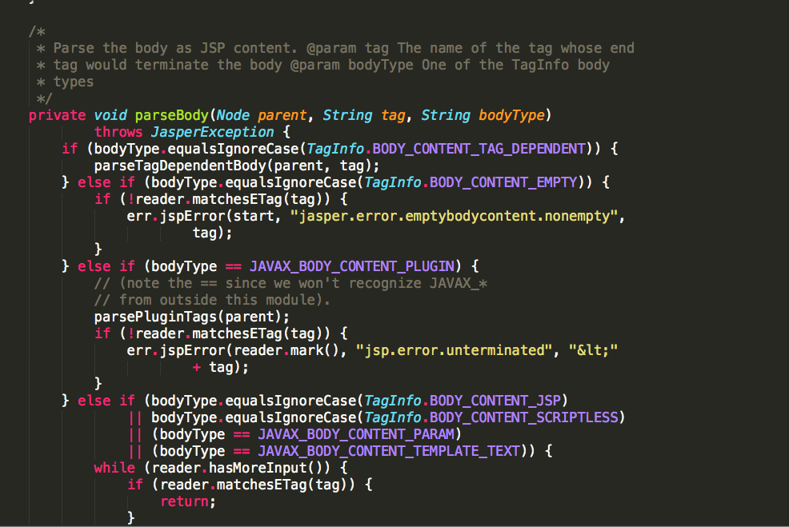

Slide 18
Too Long

Slide 19
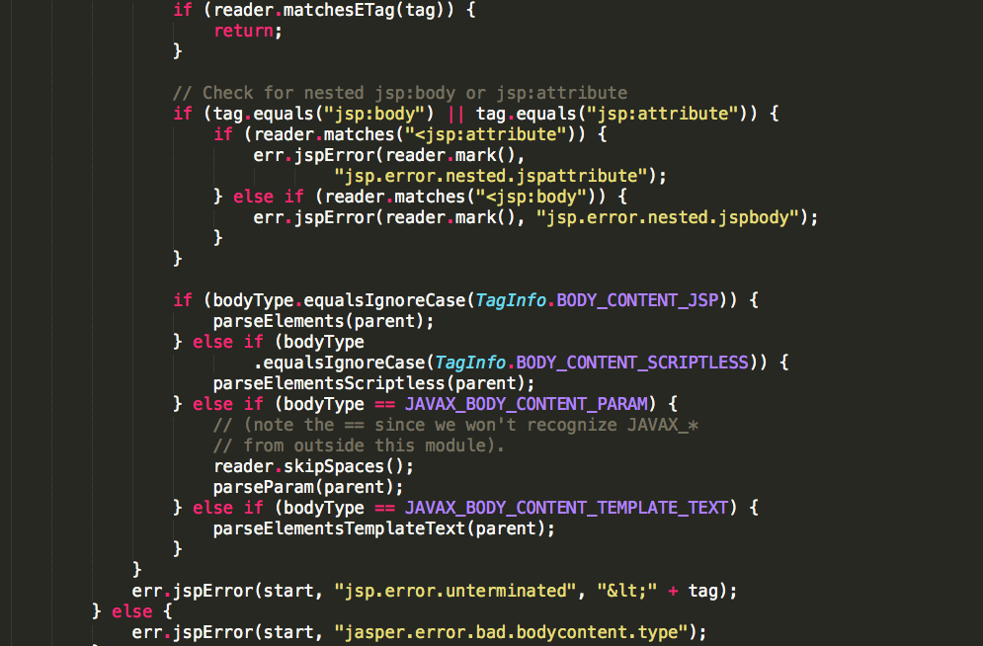

Slide 20
Too Long

Slide 21
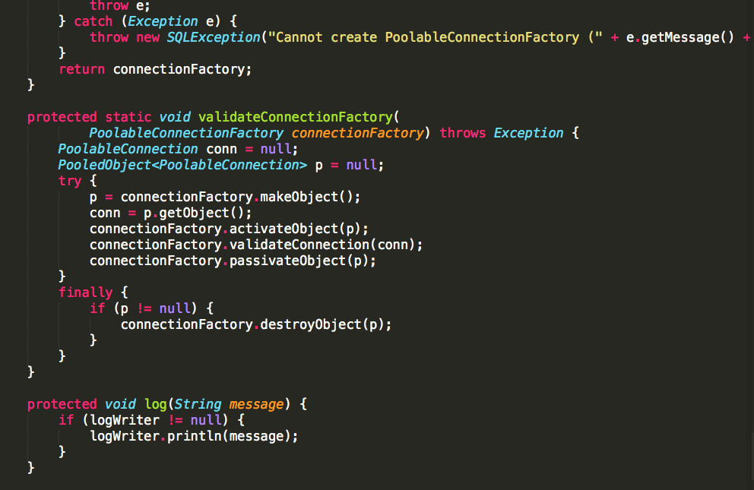

Slide 22
Short Enough

Slide 23
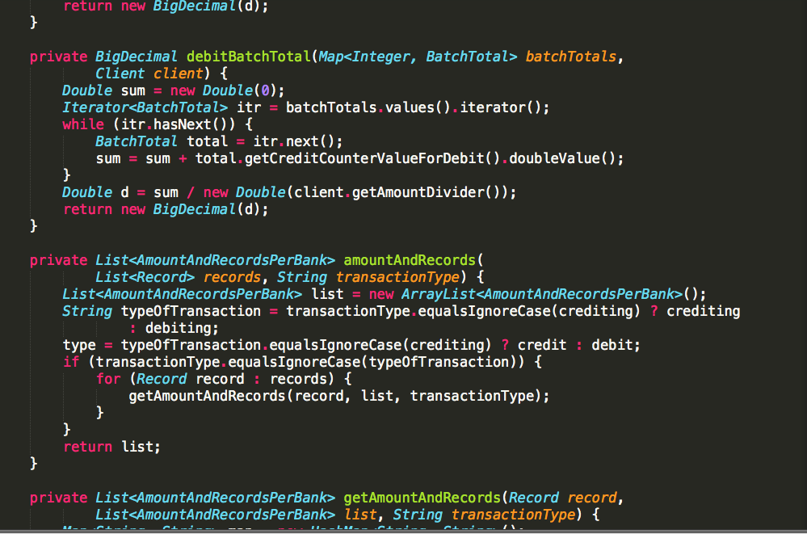

Slide 24
Short Enough

Slide 25
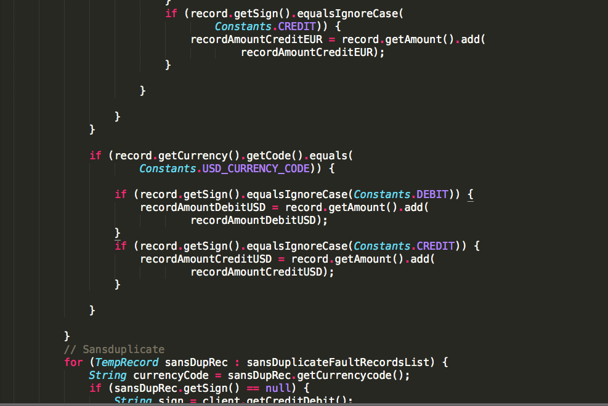

Slide 26
Too Long

Slide 27
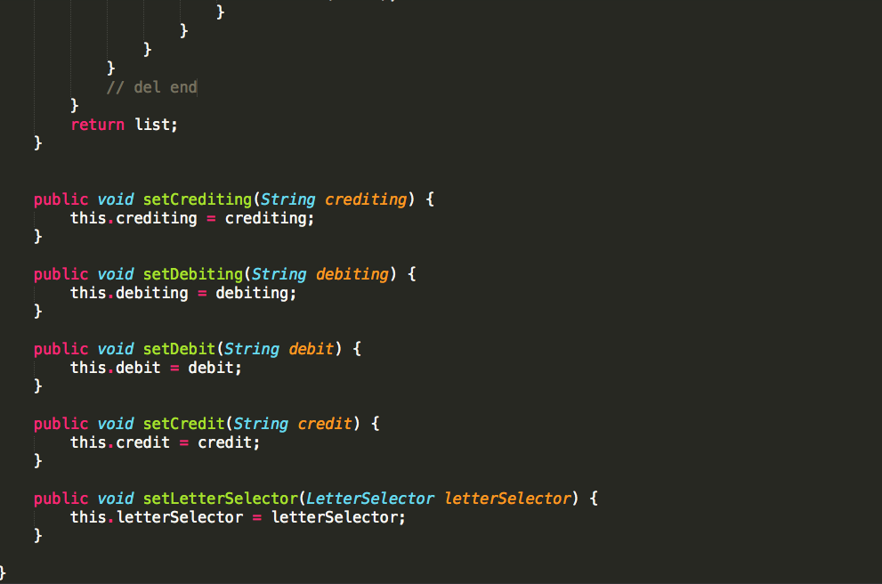

Slide 28
Short Enough

Slide 29
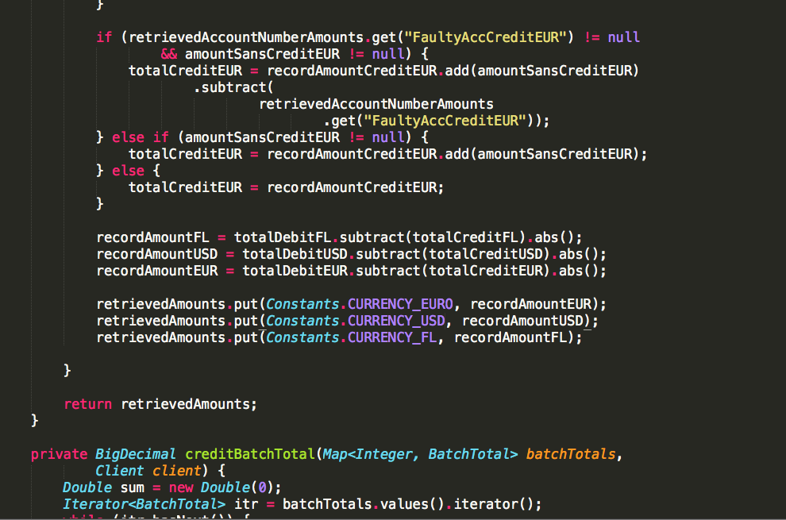

Slide 30
Too Long

Slide 31
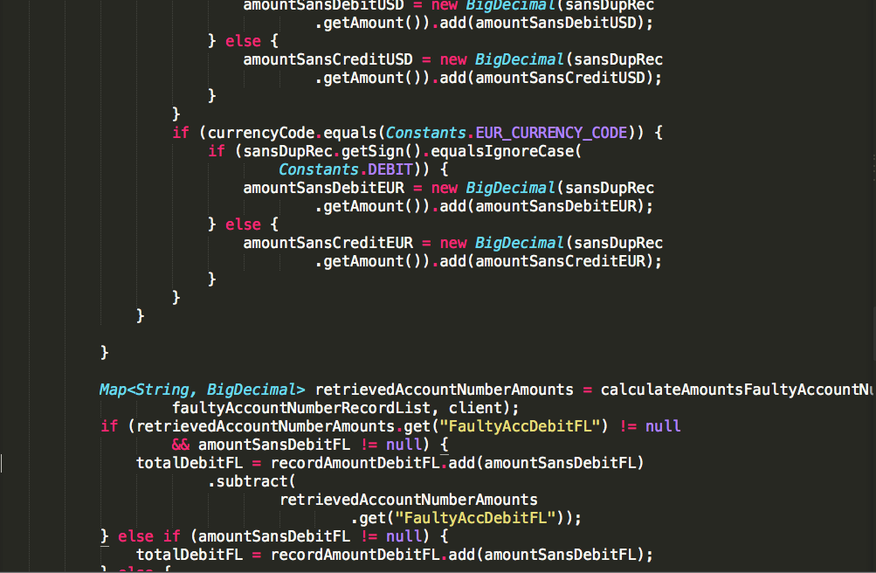

Slide 32
Too Long

Slide 33
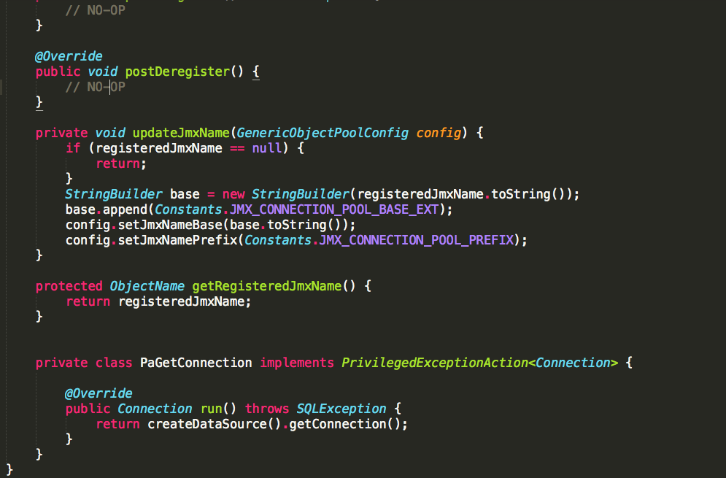

Slide 34
Short Enough

Slide 35
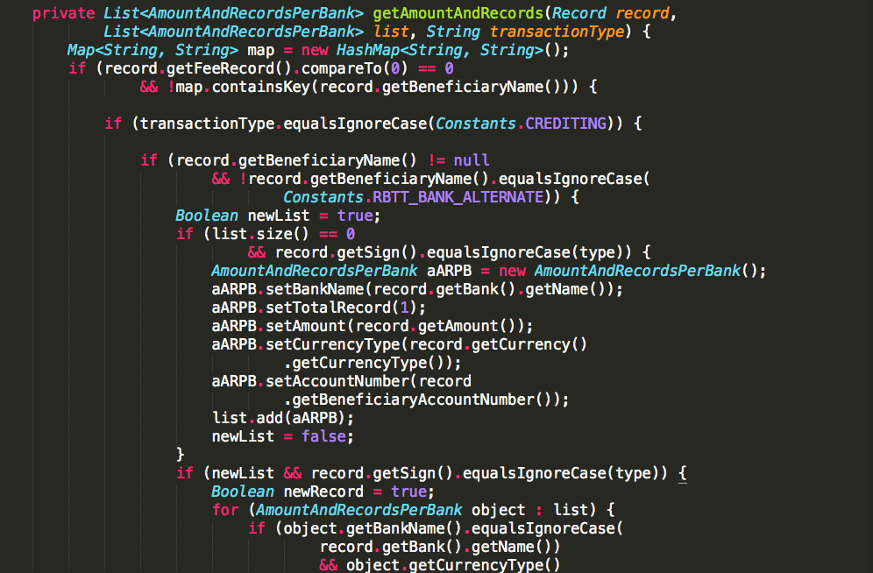

Slide 36
Too Long

Slide 37
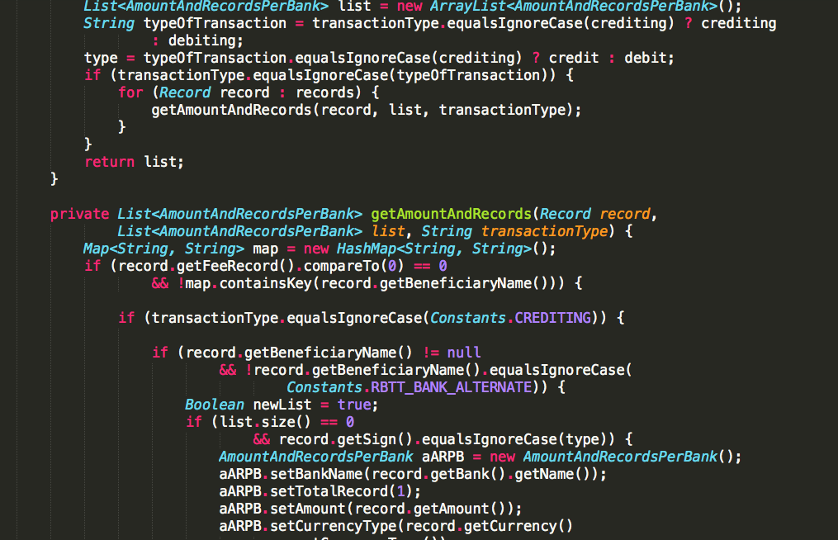

Slide 38
Too Long

Slide 39
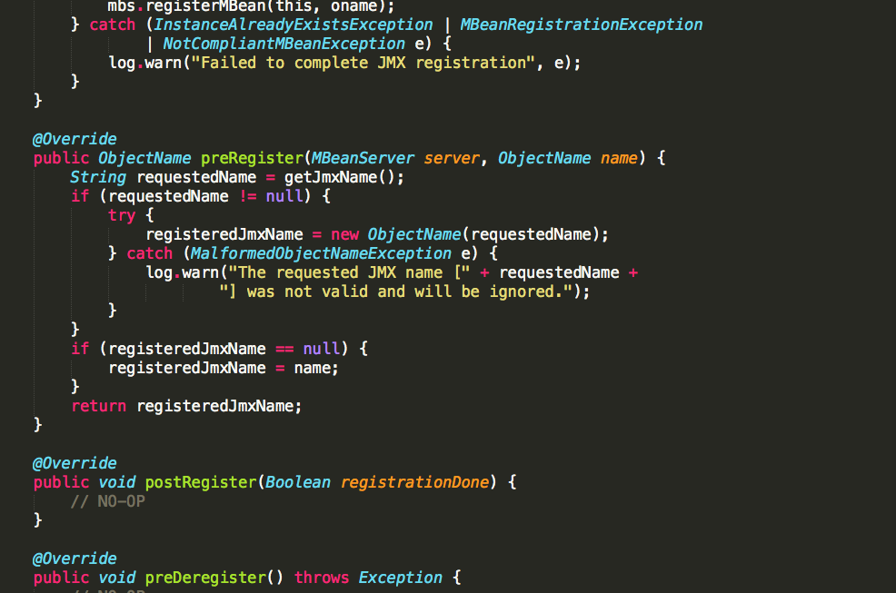

Slide 40
Short Enough

Slide 41
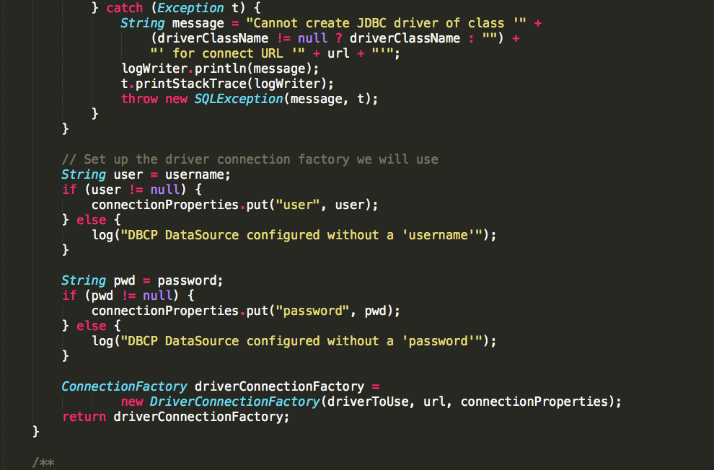

Slide 42
Too Long

Slide 43
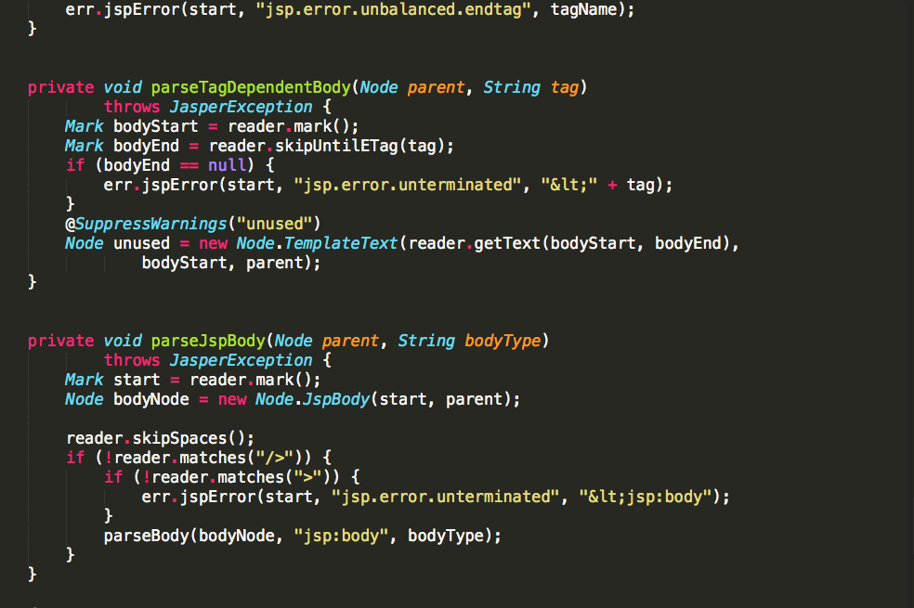

Slide 44
Short Enough

Slide 45
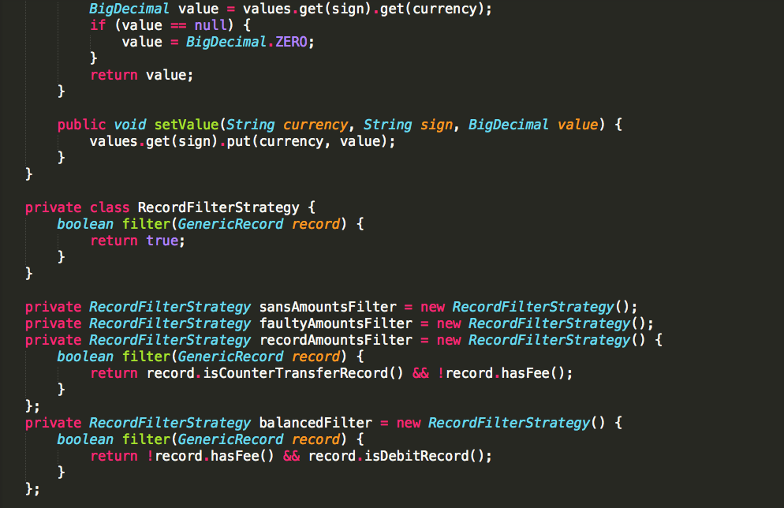

Slide 46
Short Enough

Slide 47
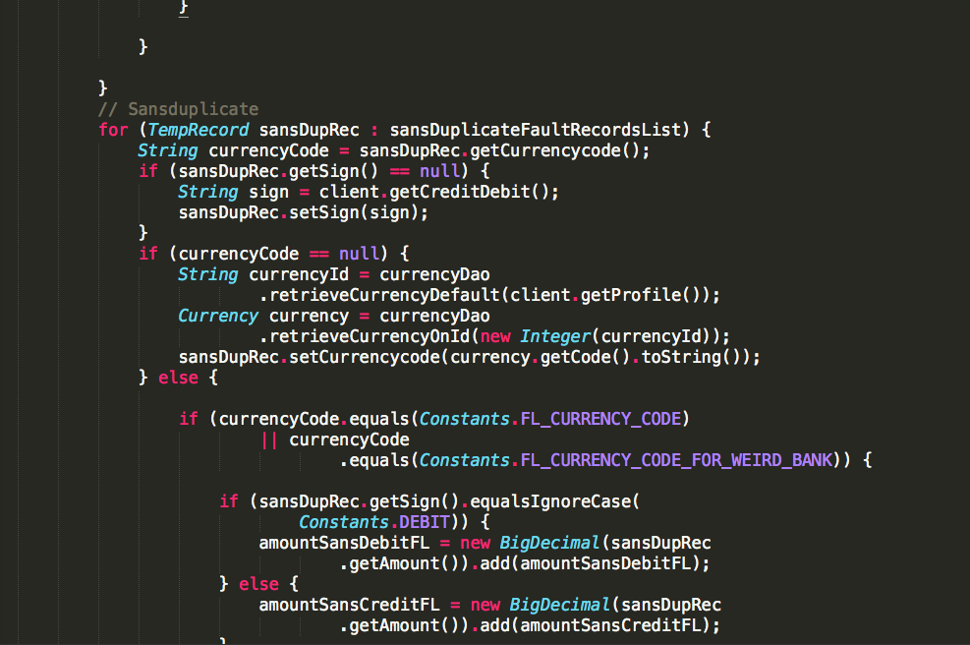

Slide 48
Too Long

Slide 49
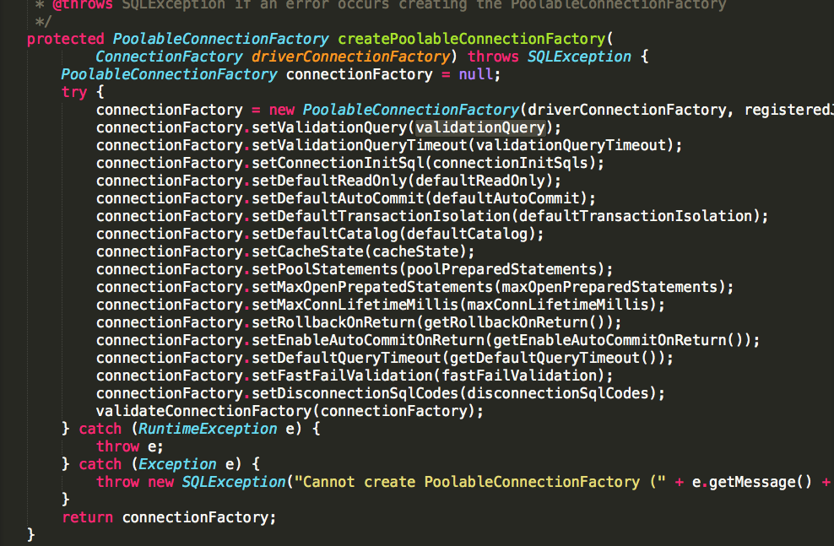

Slide 50
Short Enough

Slide 51
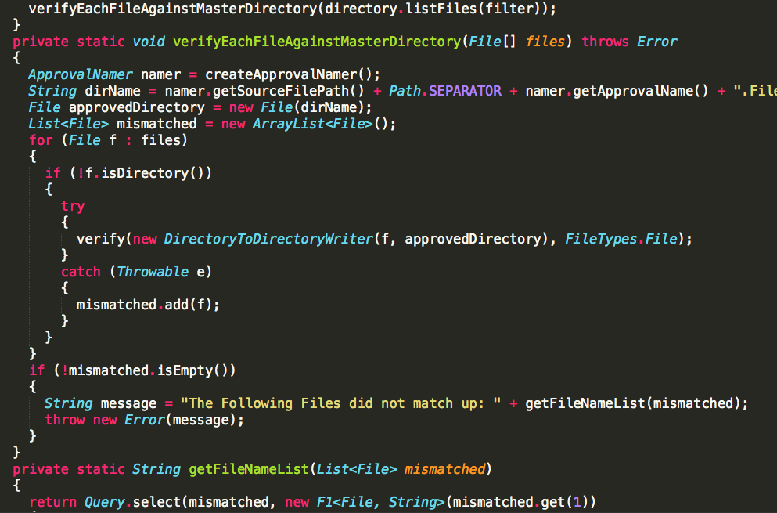

Slide 52
Short Enough

Slide 53
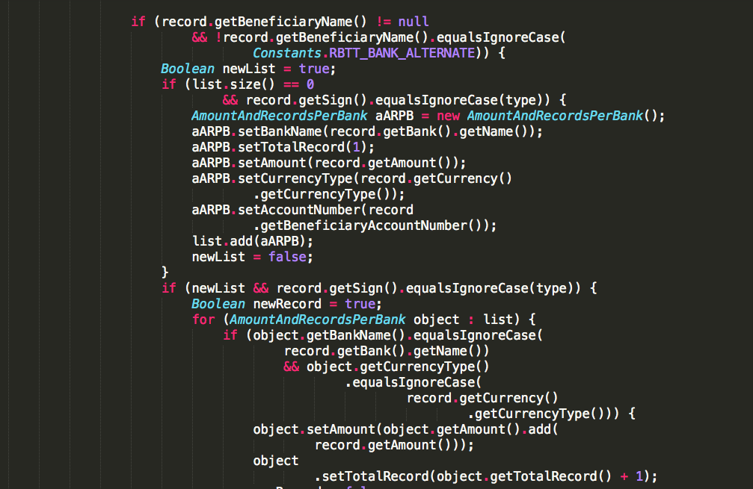

Slide 54
Too Long

Slide 55
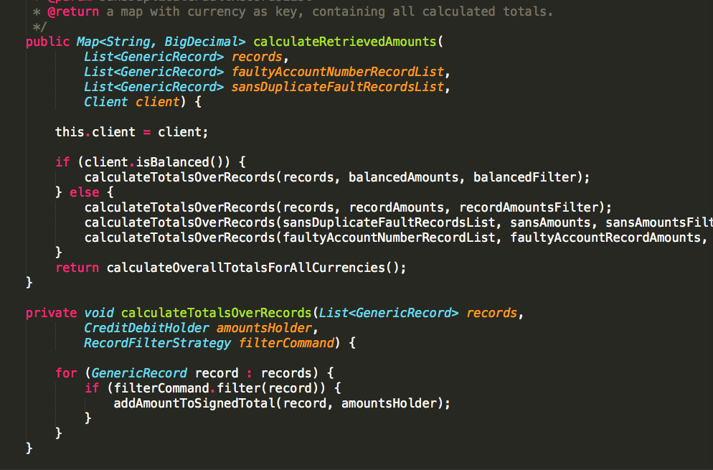

Slide 56
Short Enough

Slide 57
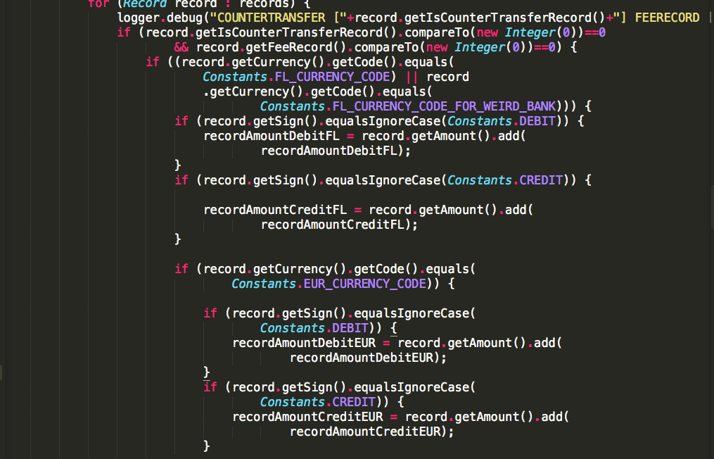

Slide 58
Too Long

Slide 59
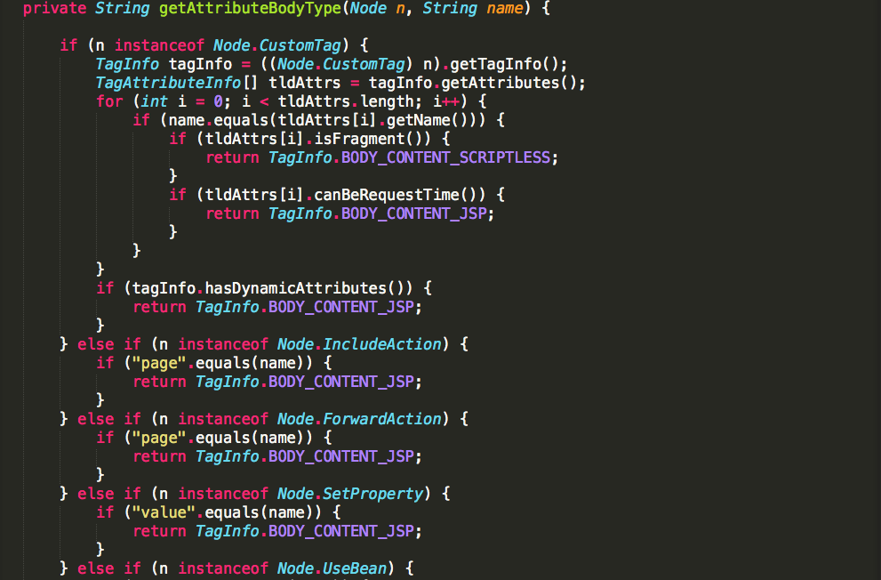

Slide 60
Too Long

Slide 61
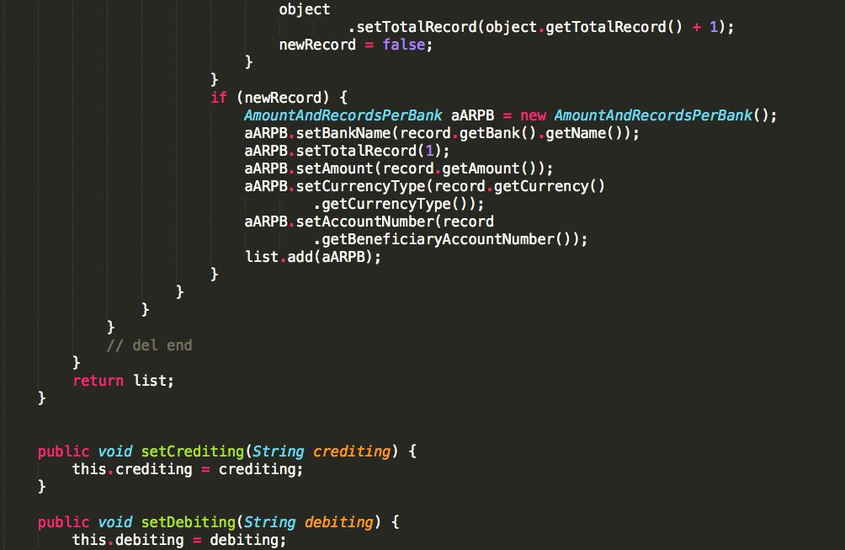

Slide 62
Too Long

Slide 63
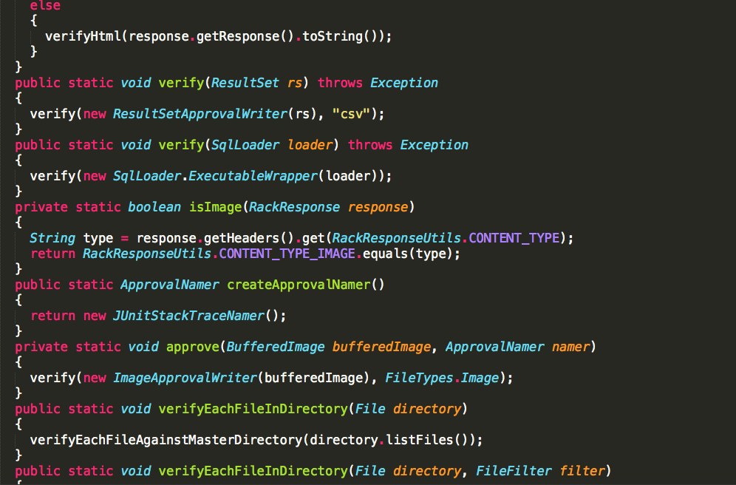

Slide 64
Short Enough

Slide 65
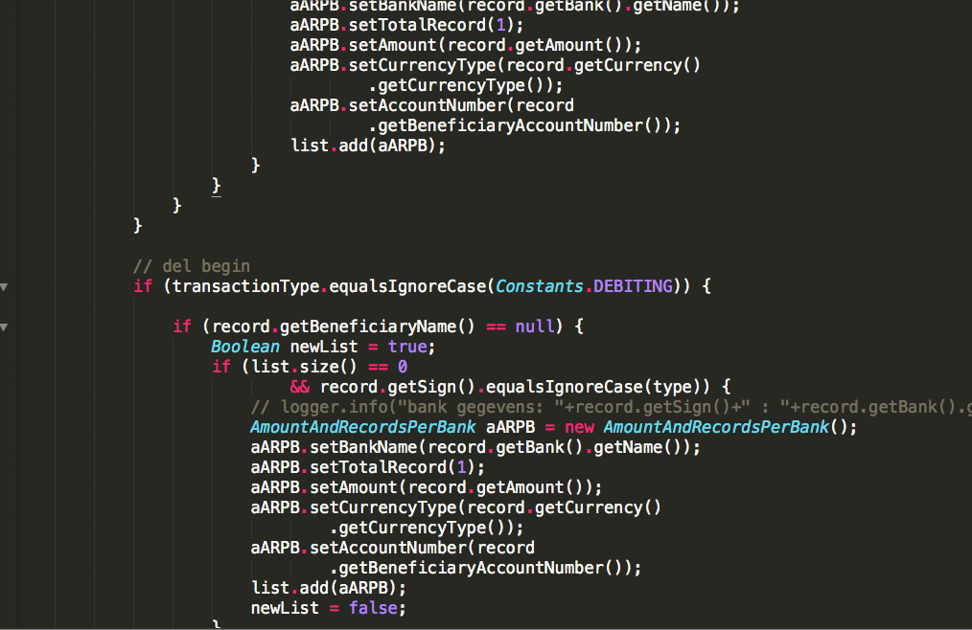

Slide 66
Too Long

Slide 67
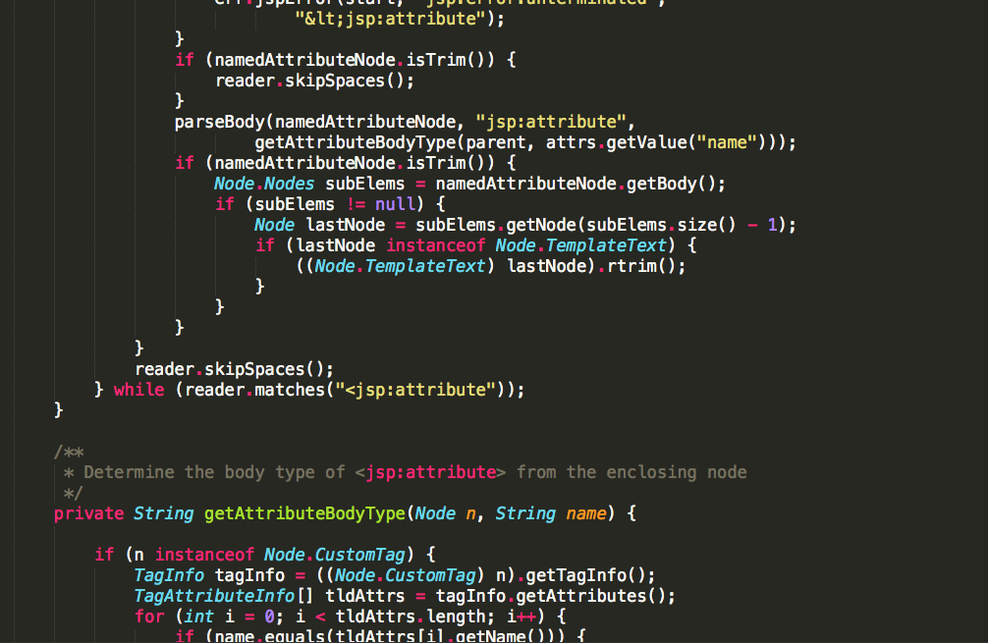

Slide 68
Too Long

Slide 69
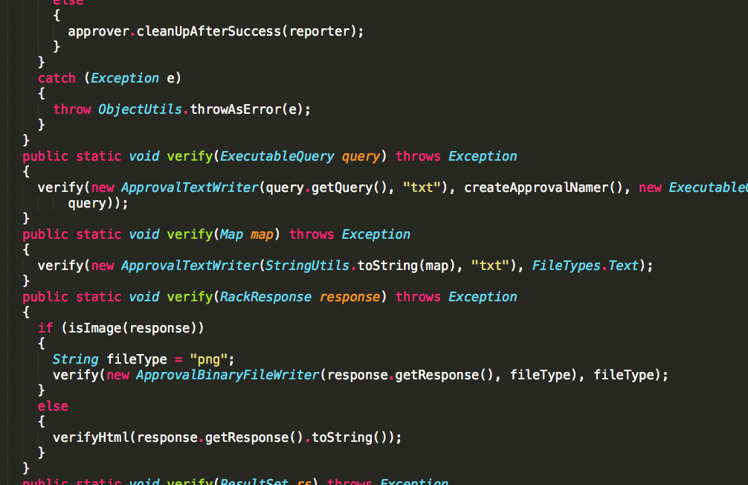

Slide 70
Short Enough

